Slide 1



HEART FAILURE ANALYSIS
Submitted By:-
Sneh Raj

Slide 2
ABOUT THE DATASET
The Heart Failure Clinical Dataset is a real world clinical dataset publicly available on Kaggle. It has total 299 records, 12 clinical attributes and 1 Target Variable(Death). Key attributes include age, anemia, high blood pressure, diabetes, smoking, creatinine phosphokinase, ejection fraction, platelet, serum creatinine, serum sodium, sex, time.

Slide 3

PROJECT OBJECTIVE
The main objective of this project is to derive relation between common clinical risk factors and heart failure of patients using SQL.
The goal is to provide insights that can aid in risk assessment and patient care.

Slide 4

METHODOLOGY
STEPS INVOLVED
Data Preprocessing - The dataset used for this project was already well-structured, with no missing, inconsistent, or duplicate values. Data types and binary columns were already in usable form.
Data Analysis - Performed descriptive and conditional aggregations using SQL queries.

Slide 5
METHODOLOGY
TOOLS
SOURCE
SQL
Heart Failure Clinical Dataset - Kaggle

Slide 6
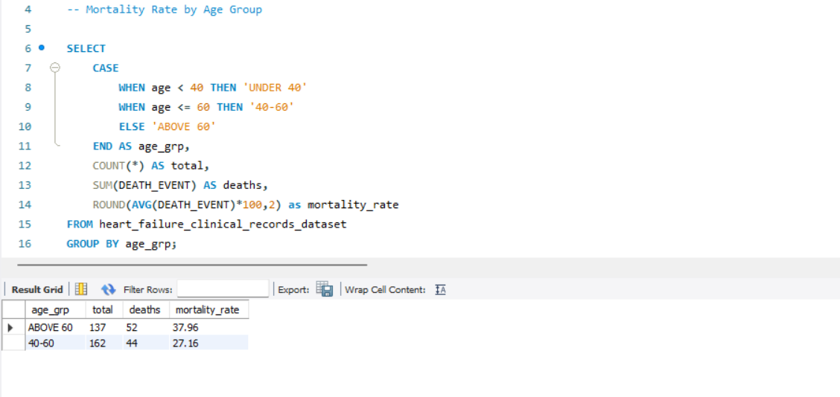
MORTALITY RATE BY AGE GROUP

Slide 7

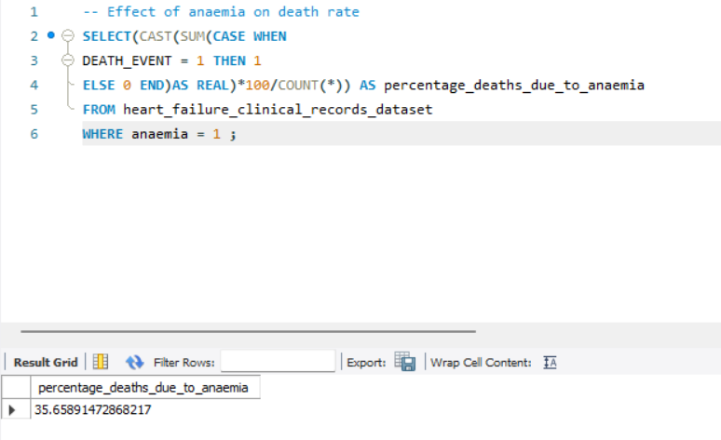
EFFECT OF ANAEMIA ON DEATH RATE

Slide 8
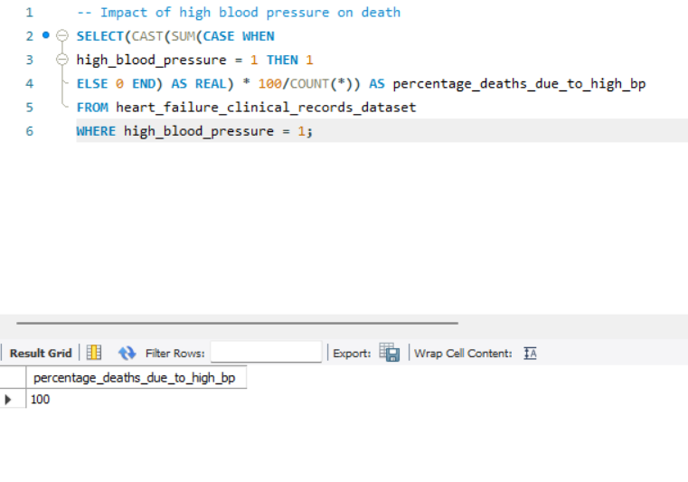
IMPACT OF HIGH BLOOOD PRESSURE ON DEATH

Slide 9
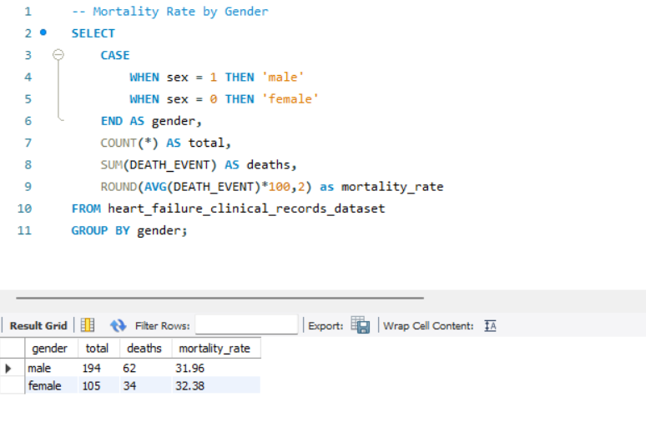
MORTALITY RATE BY GENDER

Slide 10
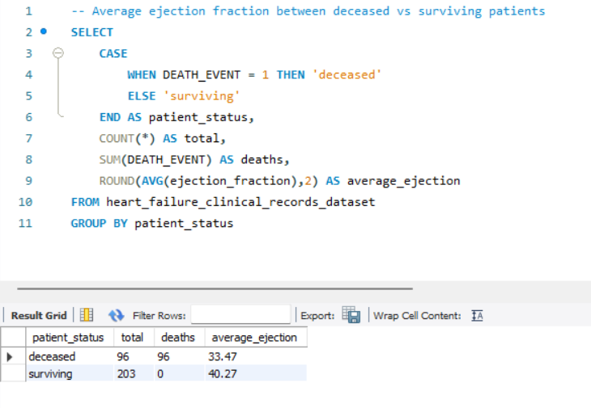
EFFECT OF EJECTION FRACTION ON DEATH

Slide 11
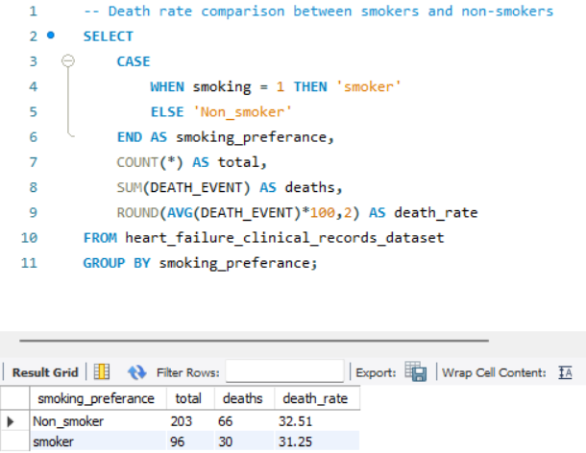
EFFECT OF SMOKING ON DEATH

Slide 12
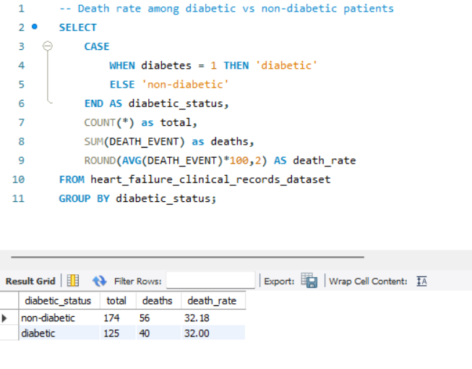
EFFECTS OF DIABETES ON DEATH

Slide 13
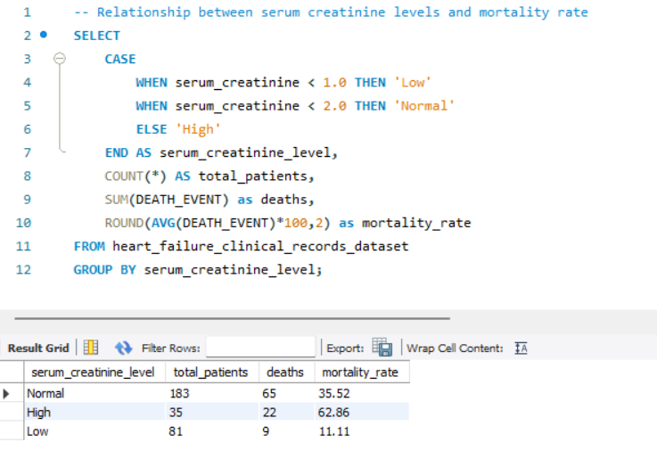
EFFECT OF SERUM CRETANINE LEVEL ON DEATH

Slide 14
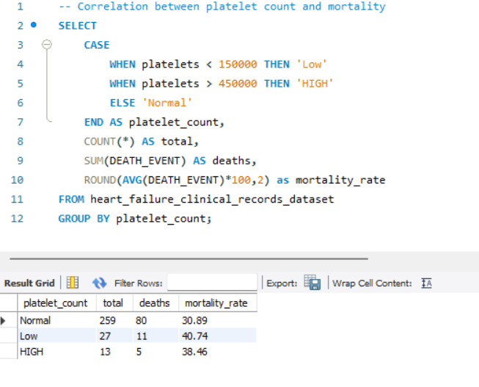
RELATION BETWEEN PLATELET COUNT AND MORTALITY

Slide 15
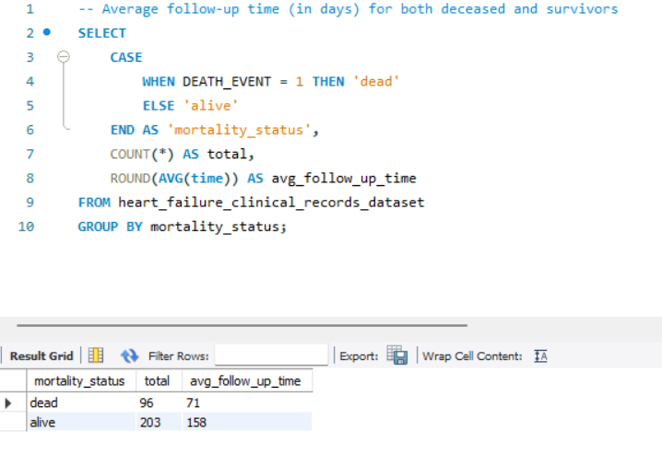
AVERAGE FOLLOW UP TIME

Slide 16
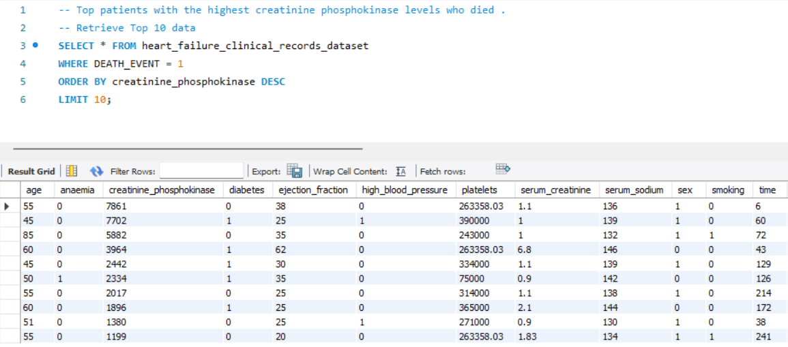
HIGHEST CRETANINE PHOSPOKINASE LEVEL

Slide 17
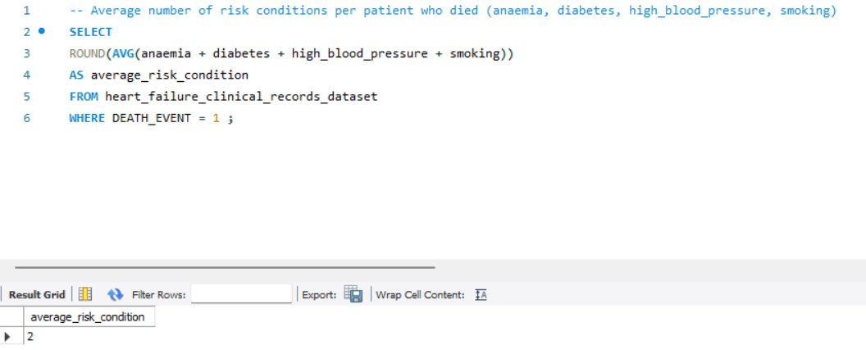
AVERAGE RISK CONDITIONS AMONG DIED PATIENTS

Slide 18
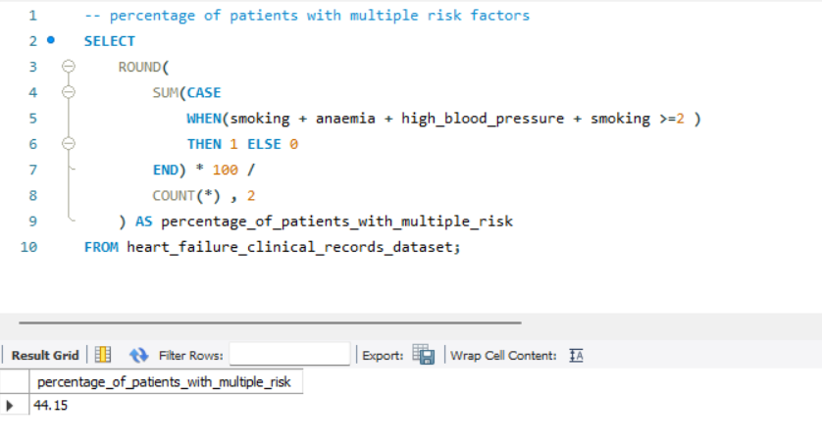
DEATH WITH 2 OR MORE RISK CONDITION

Slide 19
CONCLUSION
The analysis reveals several significant factors such as High Blood Pressure, Smoking, Anemia etc. influencing mortality in heart failure patients.

Slide 20
THANK YOU

